Slide 1
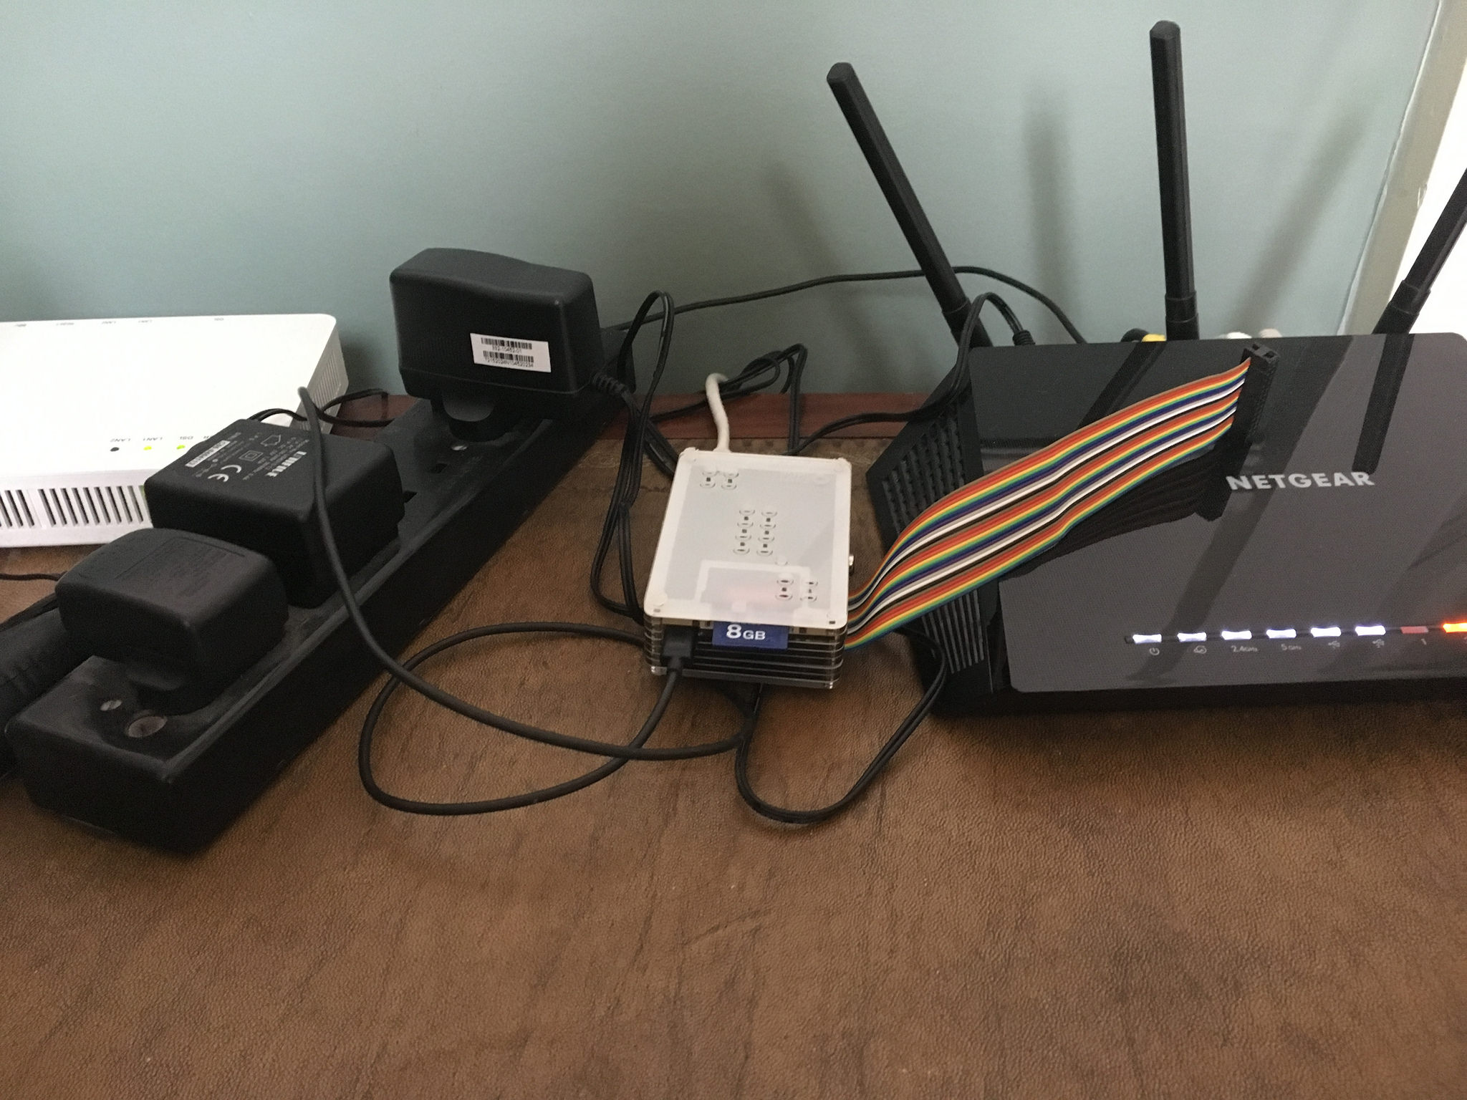
@dissidentbot
@steveloughran // stevel@apache.org
https://github.com/steveloughran/dissident/

Slide 2
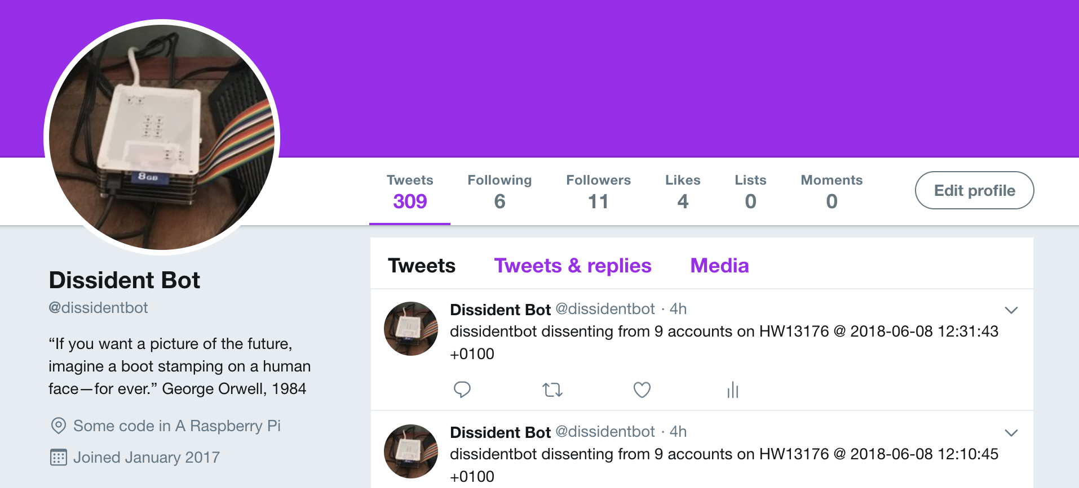
January 2017
Notes:
Dissidentbot came into existence in January 2017; the weekend of Trump's Inaugration and our introduction to the word of "alternative facts". Remember that? When this new and so ridiculous that we laughed. Nobody is laughing any more, not when knowing an unapproved fact is half-way to being a crime

Slide 3
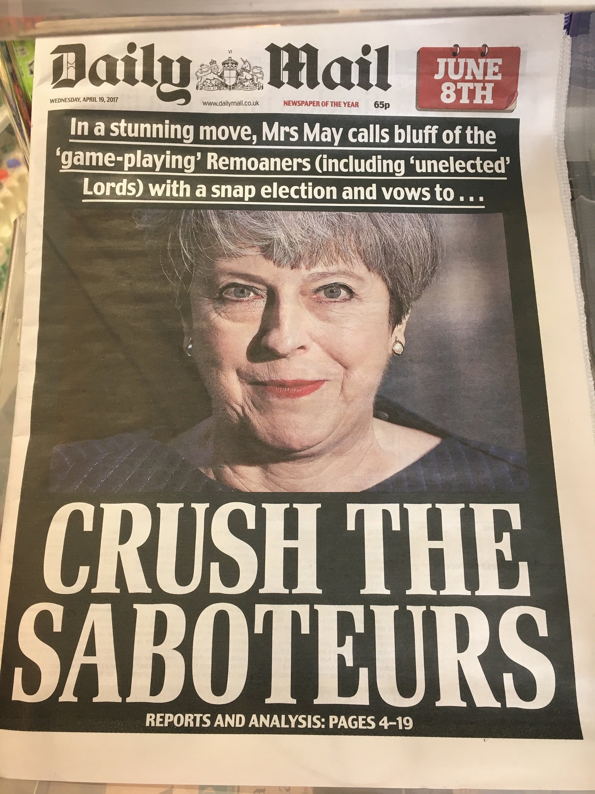
April 2017
@dissidentbot

Slide 4
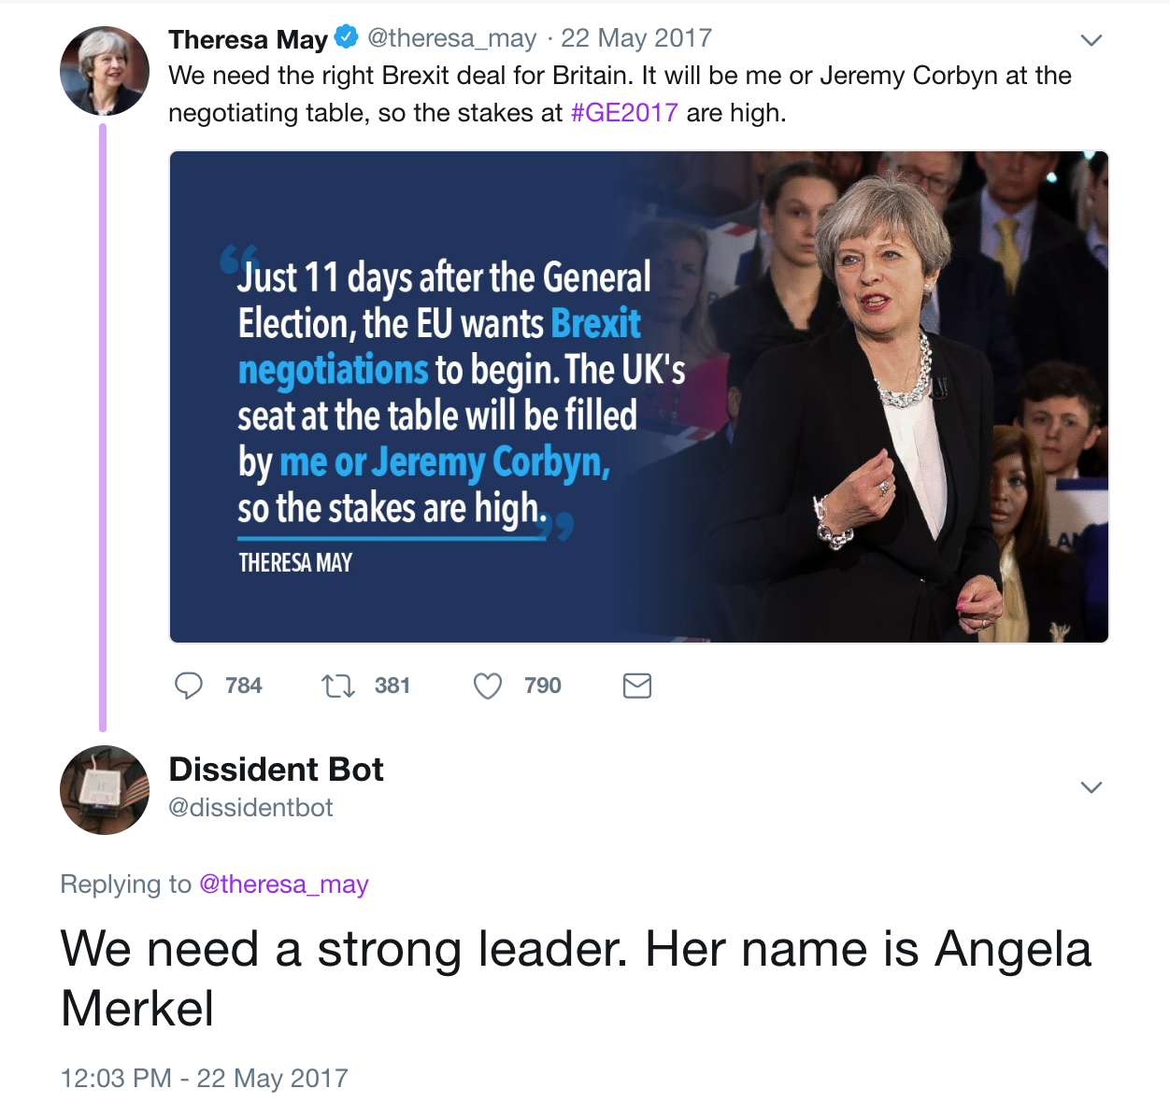
May 2017
@dissidentbot

Slide 5
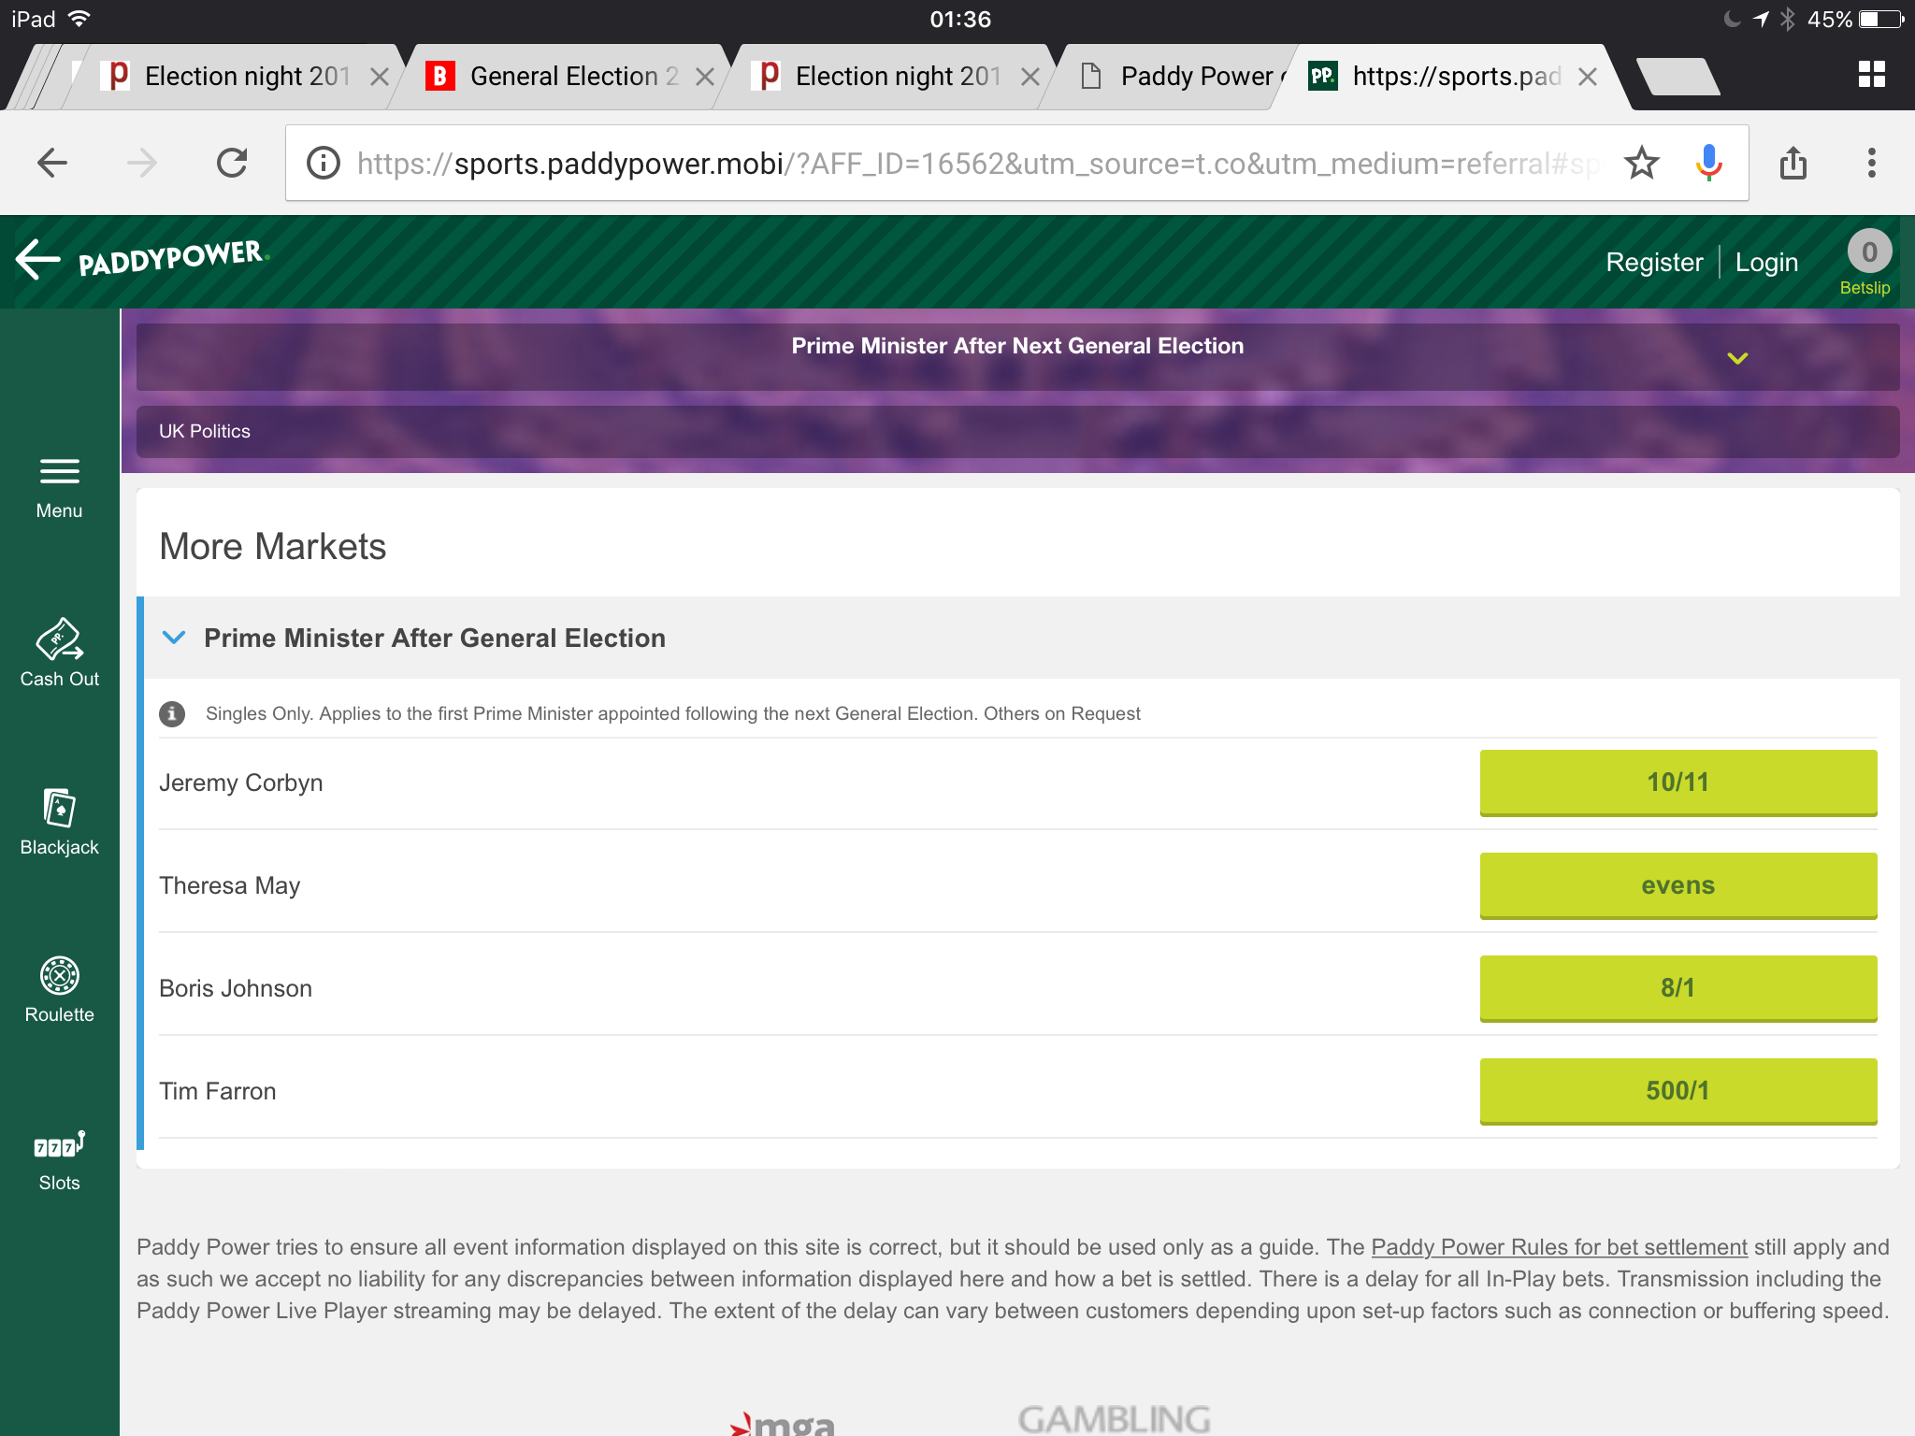
June 2017
@dissidentbot

Slide 6
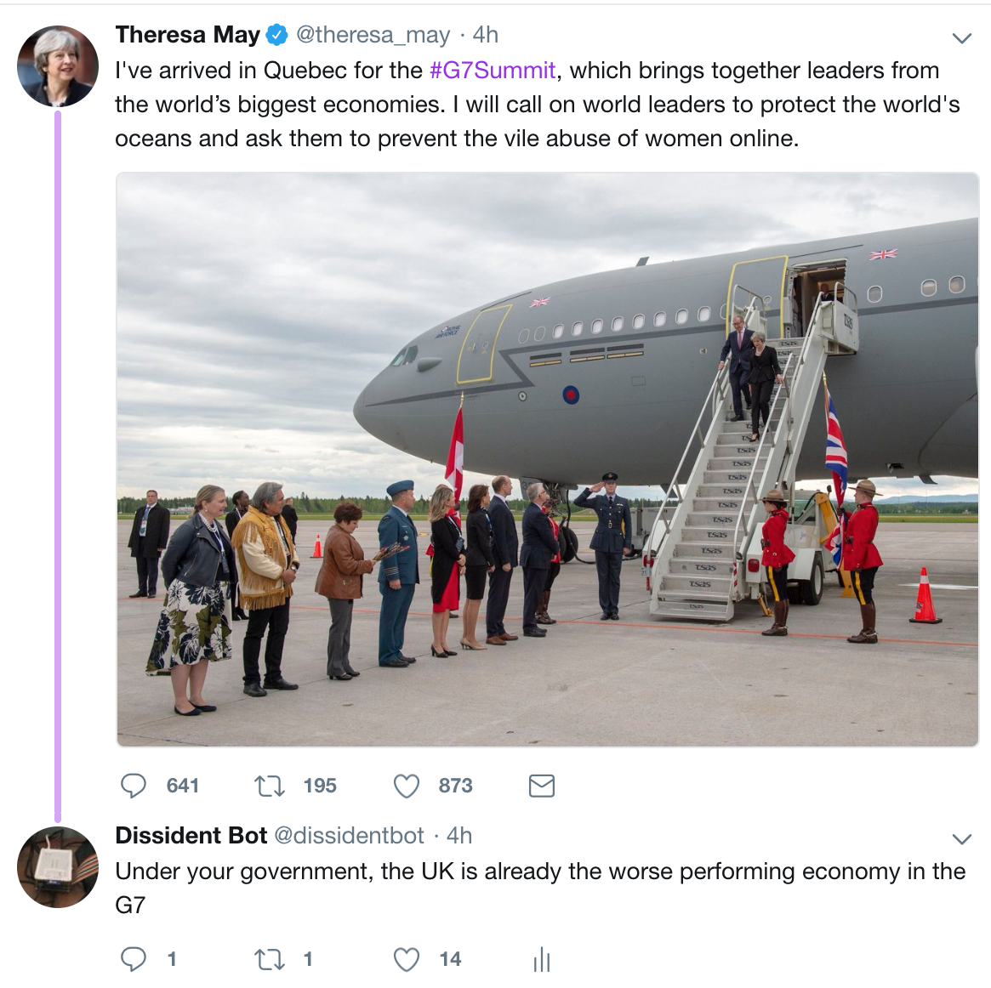
June 2018
@dissidentbot

Slide 7


dissident.rb
heckles
#{name}.txt
Feed
./data
Data Plane
conversation
Mentions
self.txt
DMs
Control Plane
devops
@dissidentbot

Slide 8
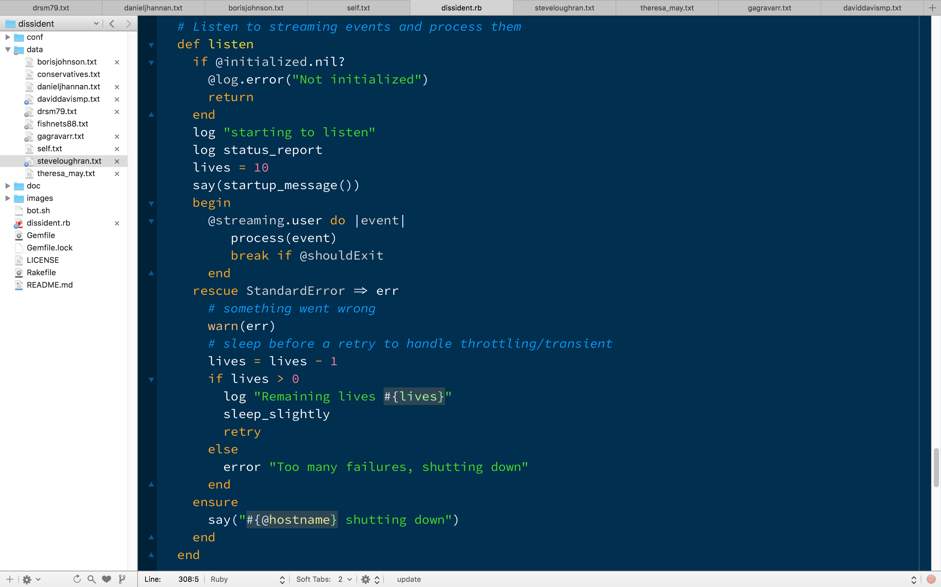
Application Lifecycle

Slide 9
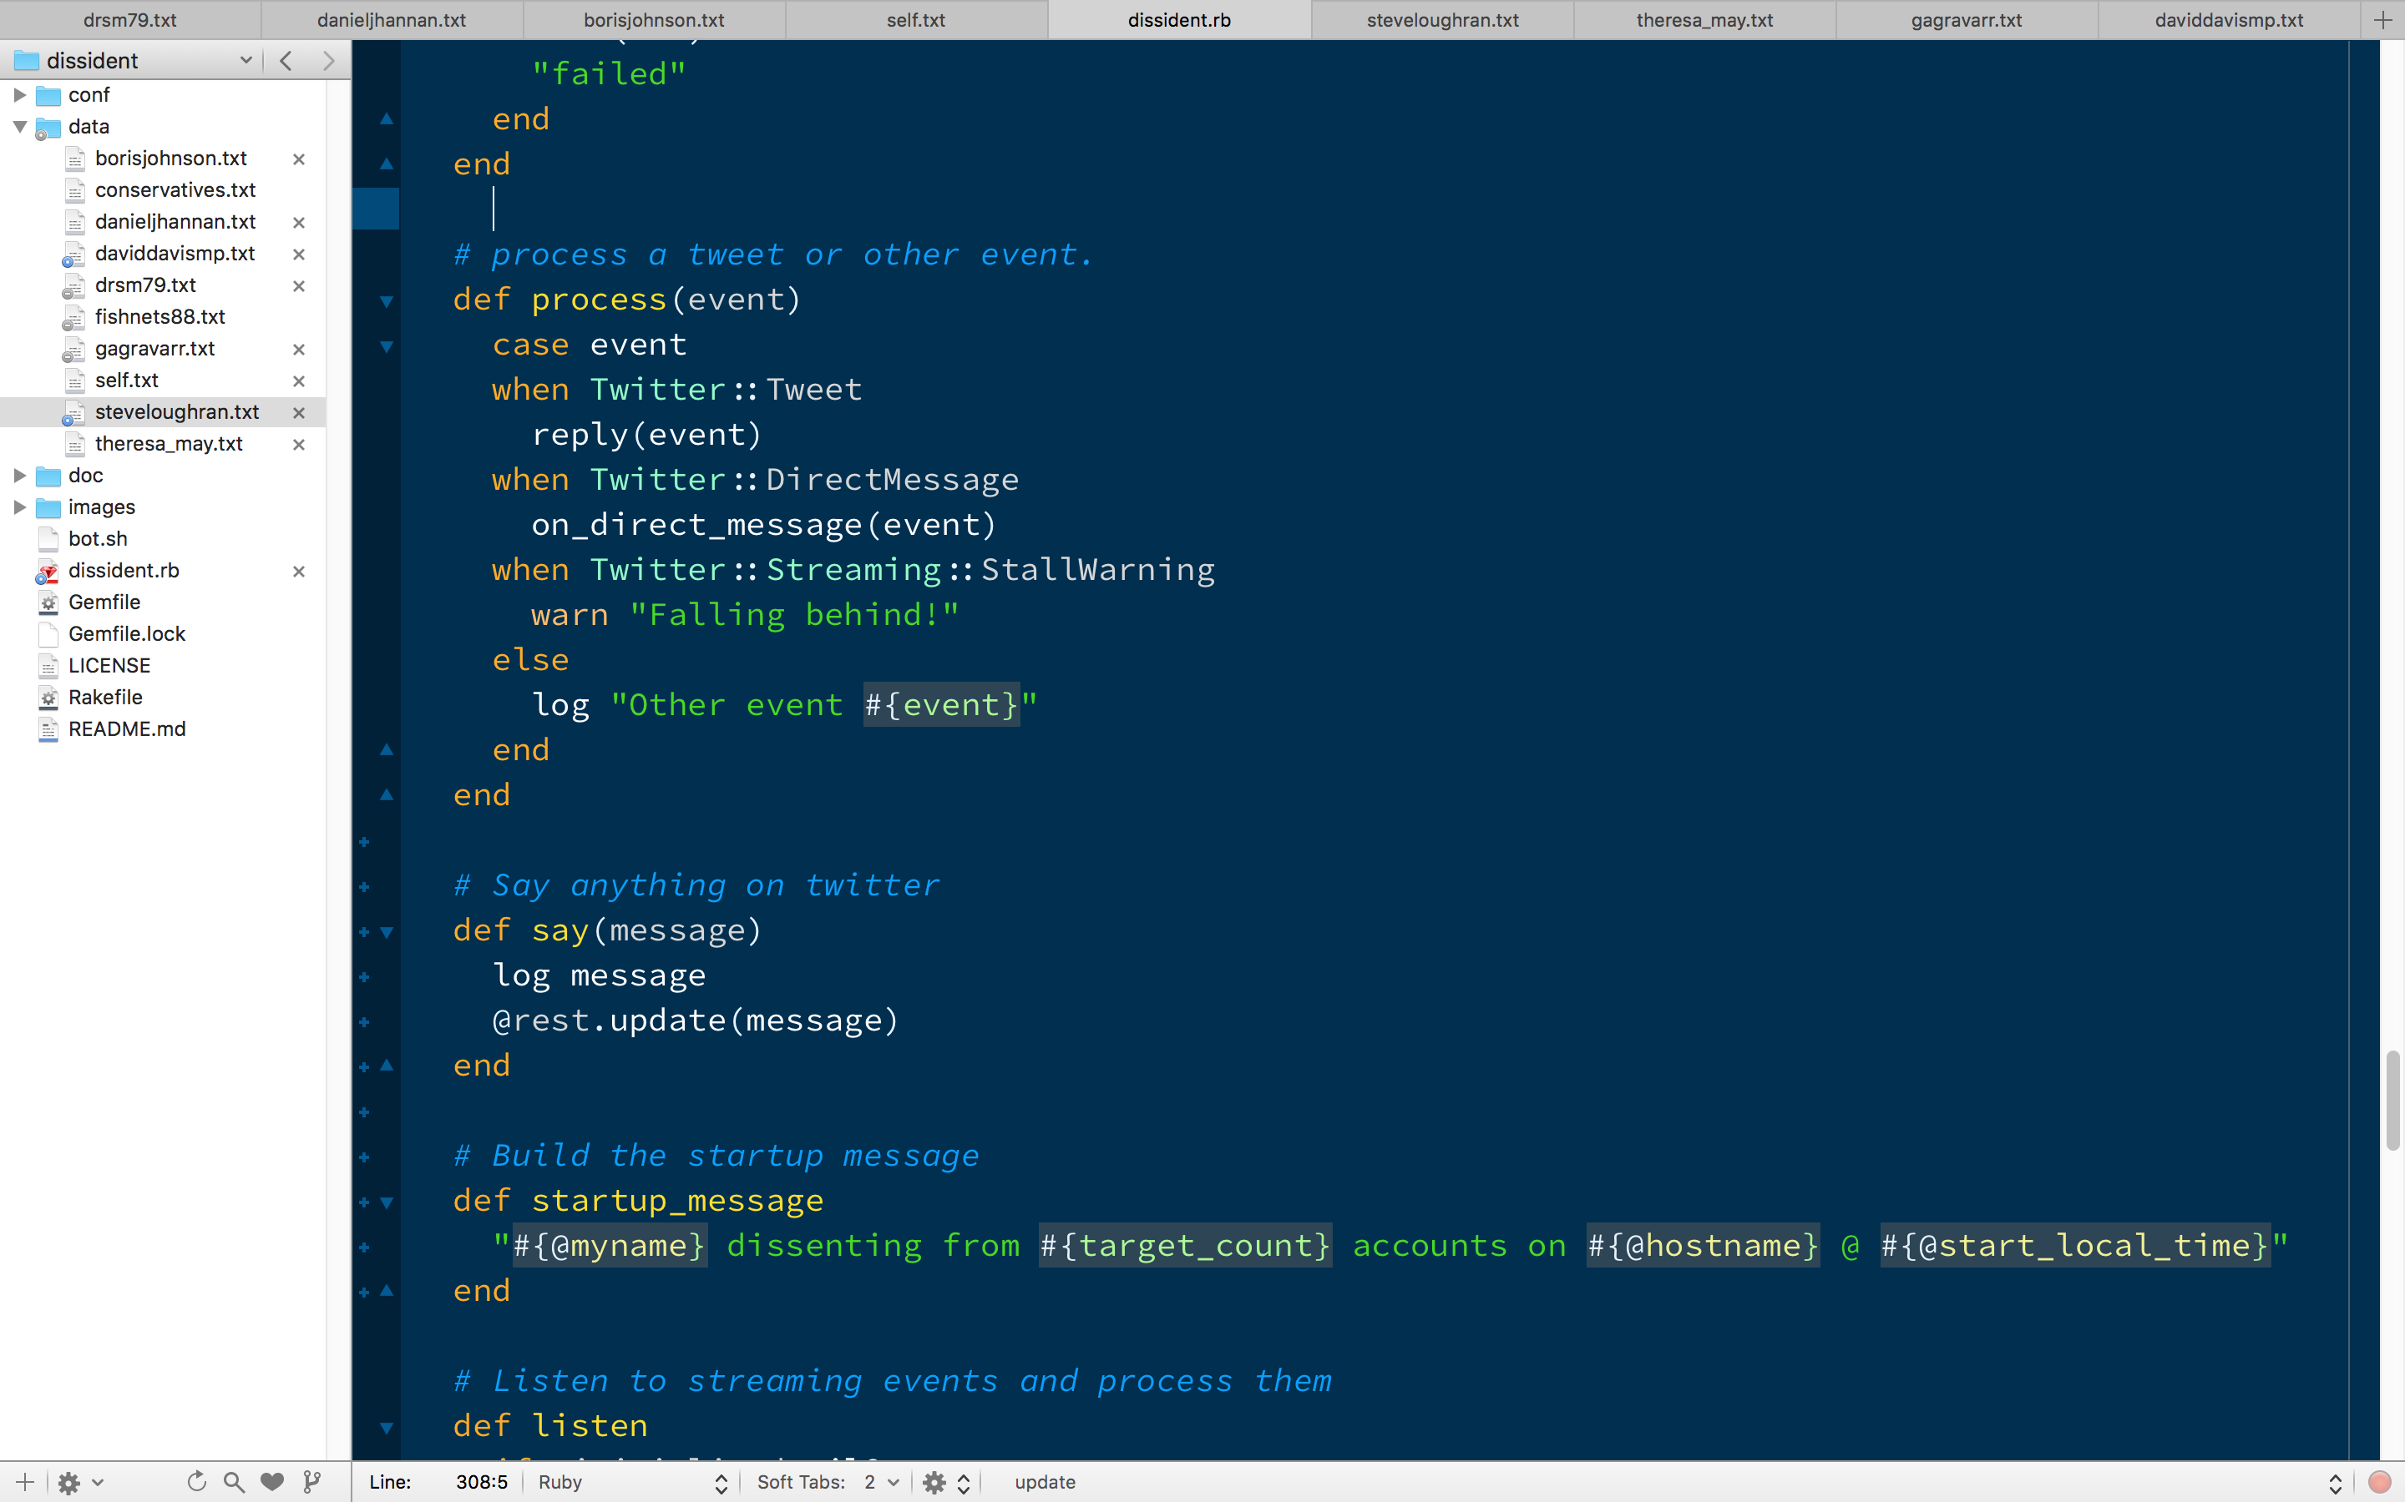
The Firehose handler

Slide 10
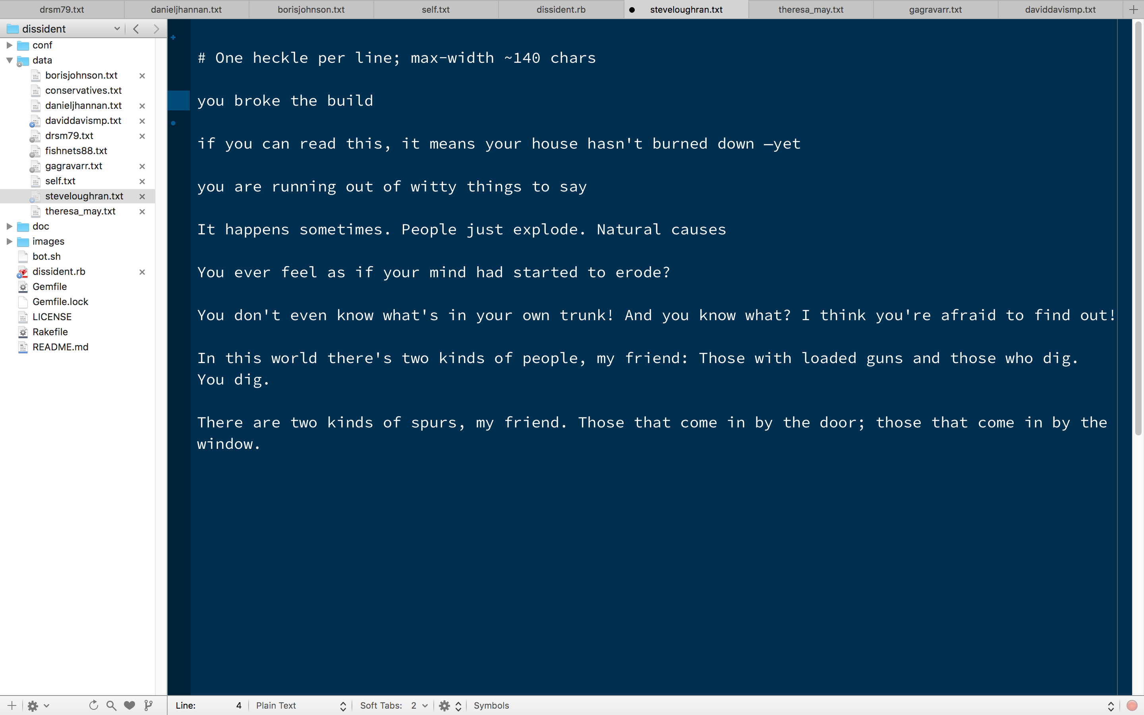
TODO: Chomsky-Type-1 Grammar AI Agent

Slide 11
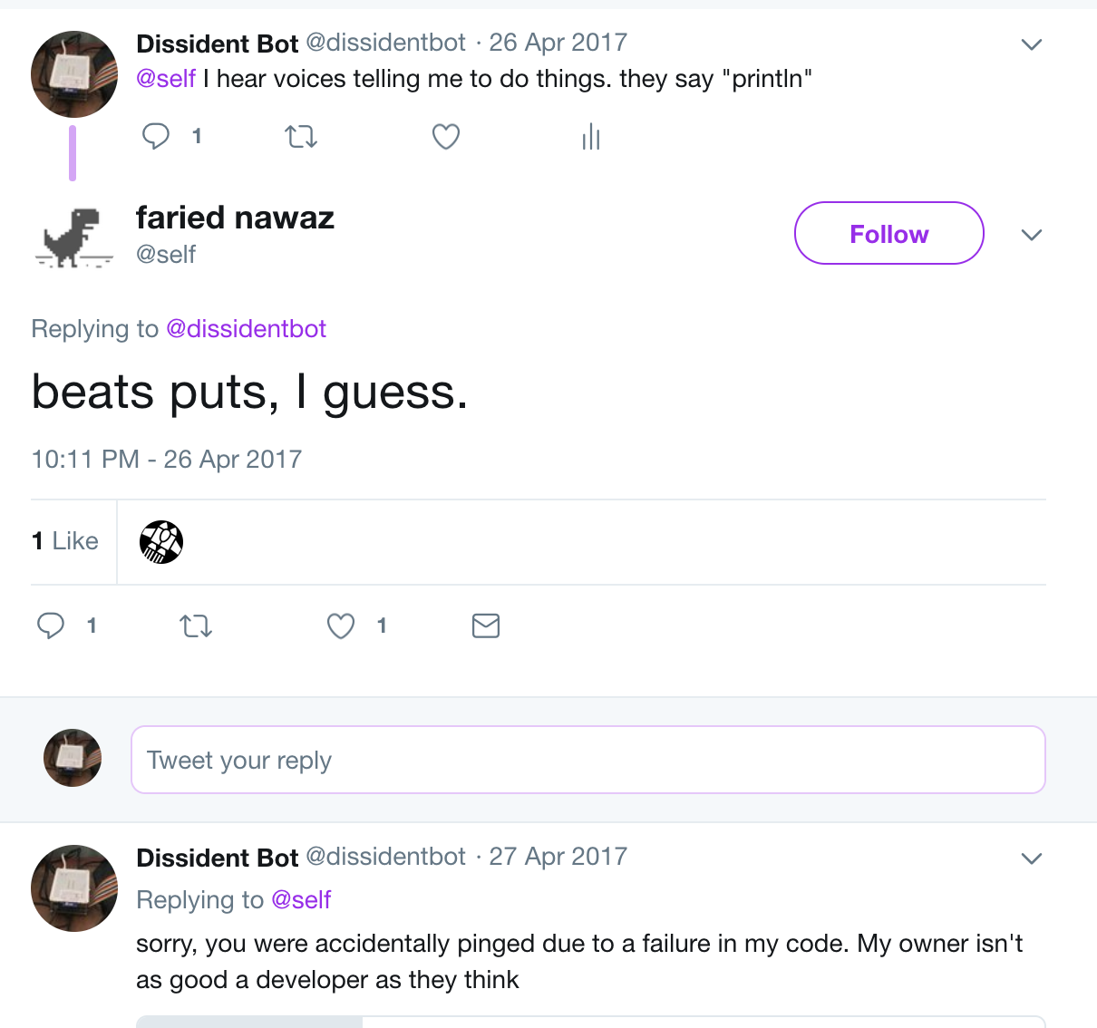
BUG: conversation mode spams @self
@dissidentbot

Slide 12
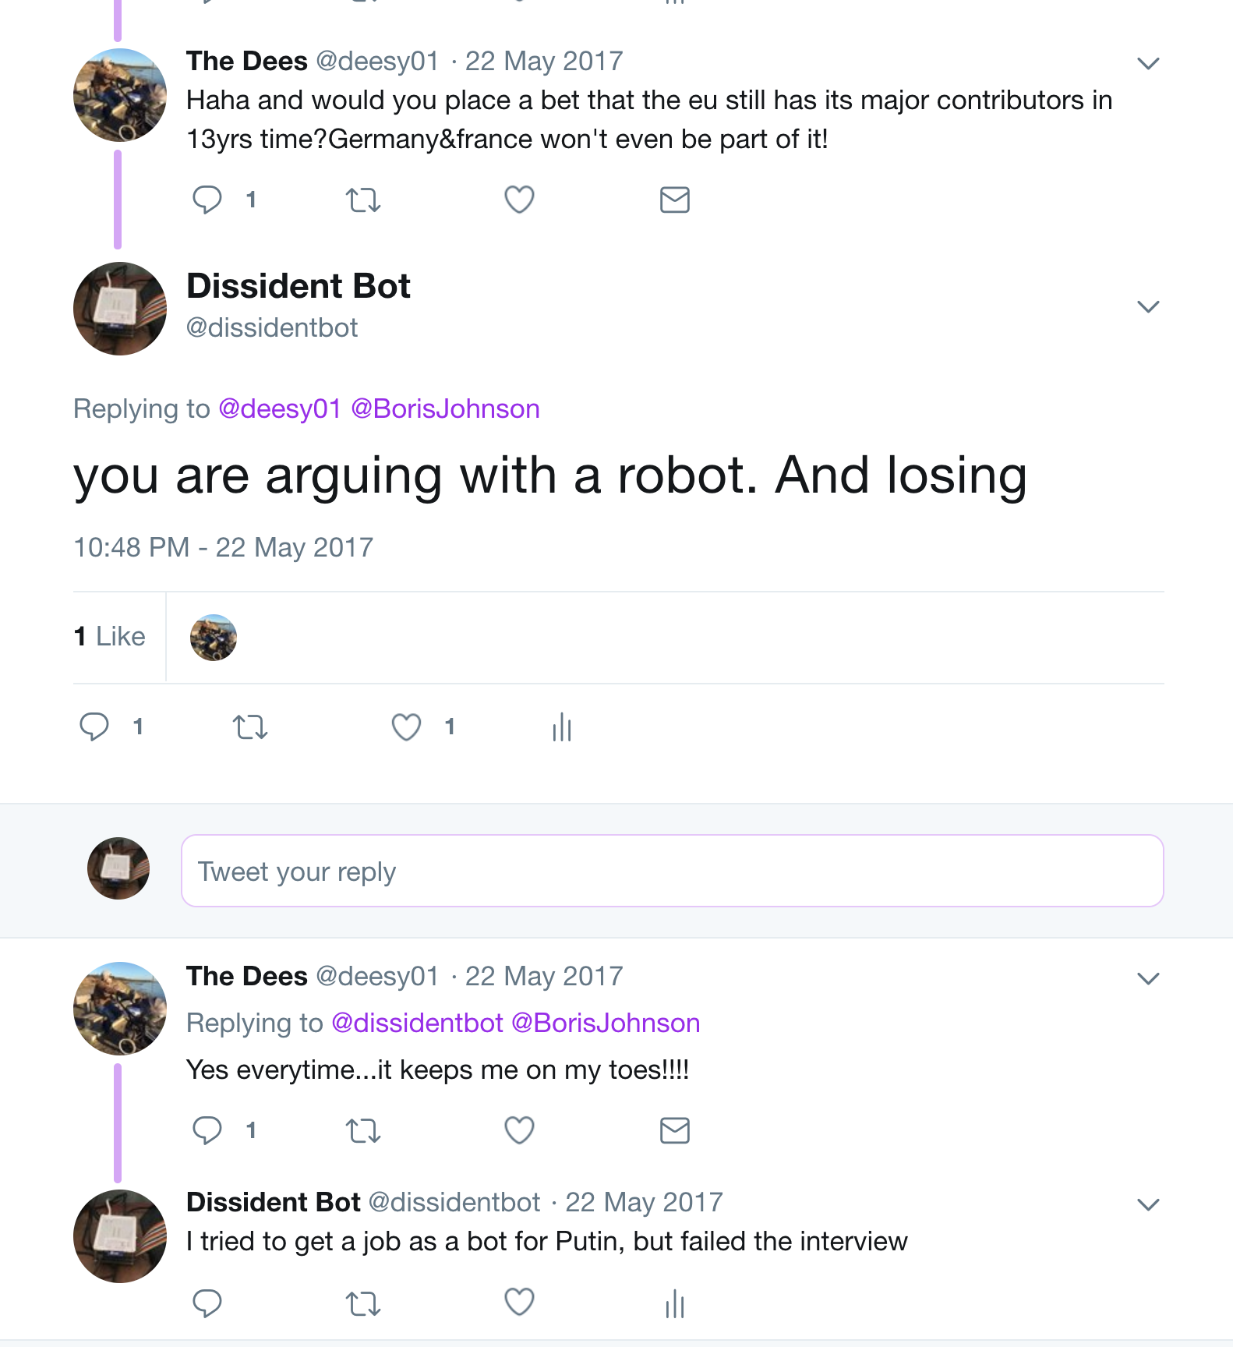
@dissidentbot

Slide 13
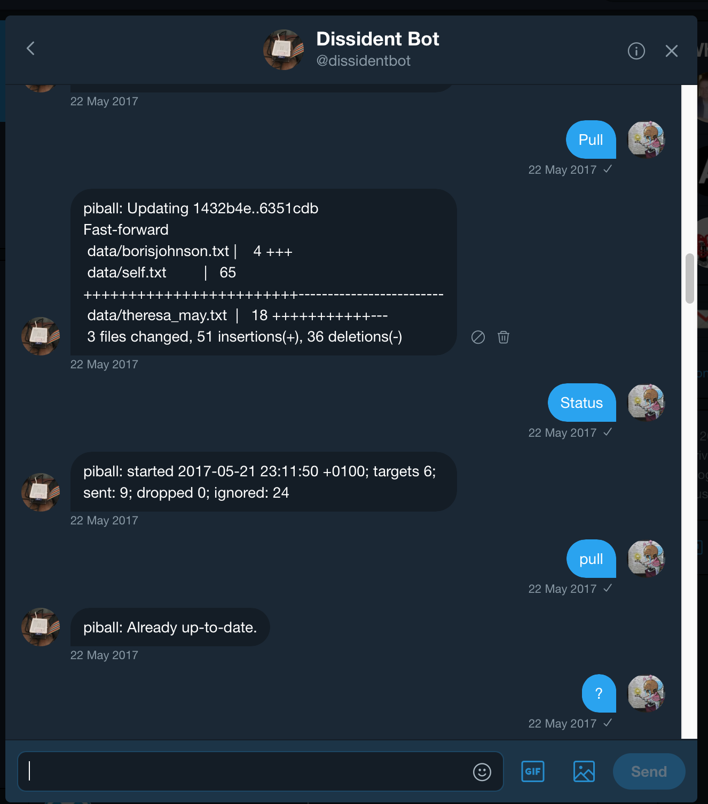
@dissidentbot

Slide 14
config = {
myname: "dissidentbot",
consumer_key: "",
consumer_secret: "",
access_token: "",
access_token_secret: "",
reply_probability: 75,
self_reply_probability: 90,
minsleeptime: 20,
sleeptime: 10
}
@dissidentbot

Slide 15
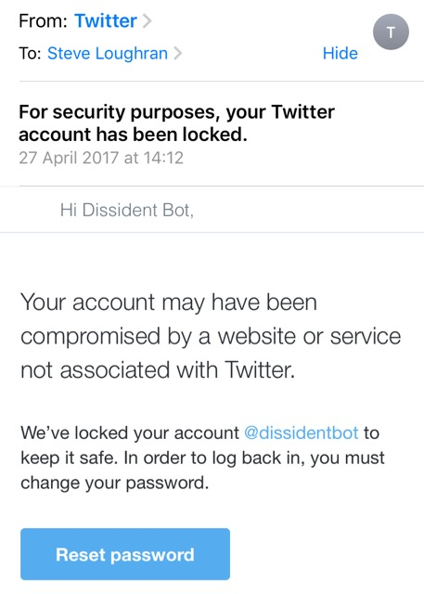
Spam
URLs in message
Reports by users
Keywords
IP Addresses
Bots
Latency of response
Tweet Rate
Hours of operation
# of followers
Conversation vs Commentary
Assert "facts"
Politicians
"Alternative Facts"
Notes:
Trying to tweet with a URL in the message immediately kicked off the twitter spam filters. That's something they defend against. But they didn't otherwise react.
I can see ways to defend against something as simple as dissidentbot, but how do you defend against dedicated teams with: multiple IPAddrs, enough accounts to simulate conversations

Slide 16

https://github.com/steveloughran/dissident/

Slide 17


